Slide 1


Power BI Desktop
Booking Status Breakdown
Date
01-07-2024 
30-07-2024 
2.02K (9.9%)
2.08K (10.2%)
Booking_Status
Success
Canceled by Driver
Canceled by Customer Driver Not Found
Total Bookings
20.41K
3.65K (17.91%)
12.65K (62%)
Total Booking Value
7M
Ride Volume Over Time
Booking Count
700
650
0
5
10
15
Day
20
25
30

Slide 2
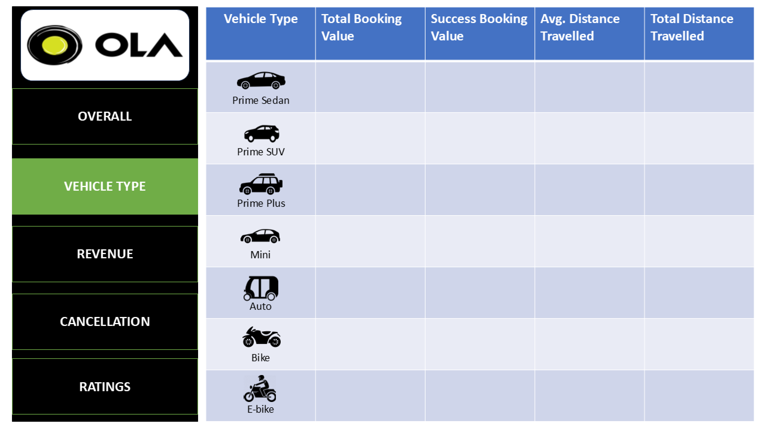
Power BI Desktop
1.67M 1.58M | 1.06M 962.25K | 24.28 25.07 | 44.97K 44.73K
1.54M | 934.88K | 24.68 | 41.46K
1.57M | 973.65K | 25.02 | 45.06K
1.59M | 992.78K | 10.00 | 18.12K
1.58M | 985.07K | 25.70 | 47.64K
1.62M | 994.76K | 25.16 | 46.99K

Slide 3
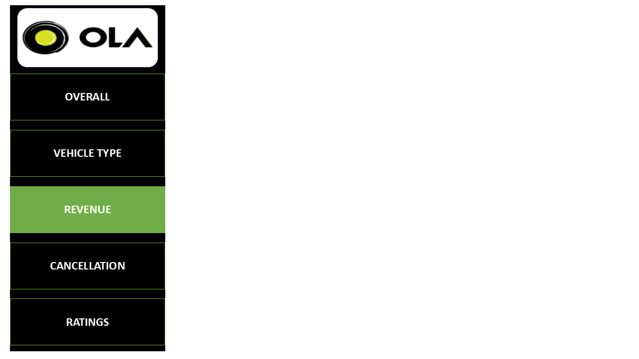

Revenue By Payment Method
Date 
Power BI Desktop
4M
3.8M
01-07-2024 
30-07-2024 
Booking Value
3M
2.8M
2M
1M
Customer_ID | Sum of Booking_Value
CID185837 | 3313
CID307511 | 3242
CID353074 | 3269
CID749265 | 3429
CID836942 | 3757
Total | 17010
0.2M
0.1M
Debit Card
0M
Cash
UPI Credit Card
Payment_Method
Revenue By Payment Method
10.8K
10.3K
10.4K
10.1K
9.7K
10.1K
9.8K
9.6K
10K
9.3K
8.9K
8.8K
8.4K
Sum of Ride_Distance
5K
0K
0
5
10
15
Day
20
25
30

Slide 4



Cancelled Rides By Customers
Date 
Power BI Desktop
01-07-2024 
30-07-2024 
191 (9.18%)
320 (15.38%)
610 (29.31%)
Canceled_Rides_by_Customer
Driver is not moving towards …
Driver asked to cancel Change of plans
AC is Not working Wrong Address
Total Bookings
20.41K
408 (19.61%)
Success Bookings
12.65K
552 (26.53%)
Cancelled Rides By Drivers
Cancel Bookings
5735
0.59K (16.01%)
1.26K (34.56%)
Canceled_Rides_by_Driver
Personal & Car related issue
Customer related issue
Customer was coughing/sick More than permitted people i…
Cancellation Rate
28.10
0.74K (20.31%)
1.06K (29.12%)

Slide 5
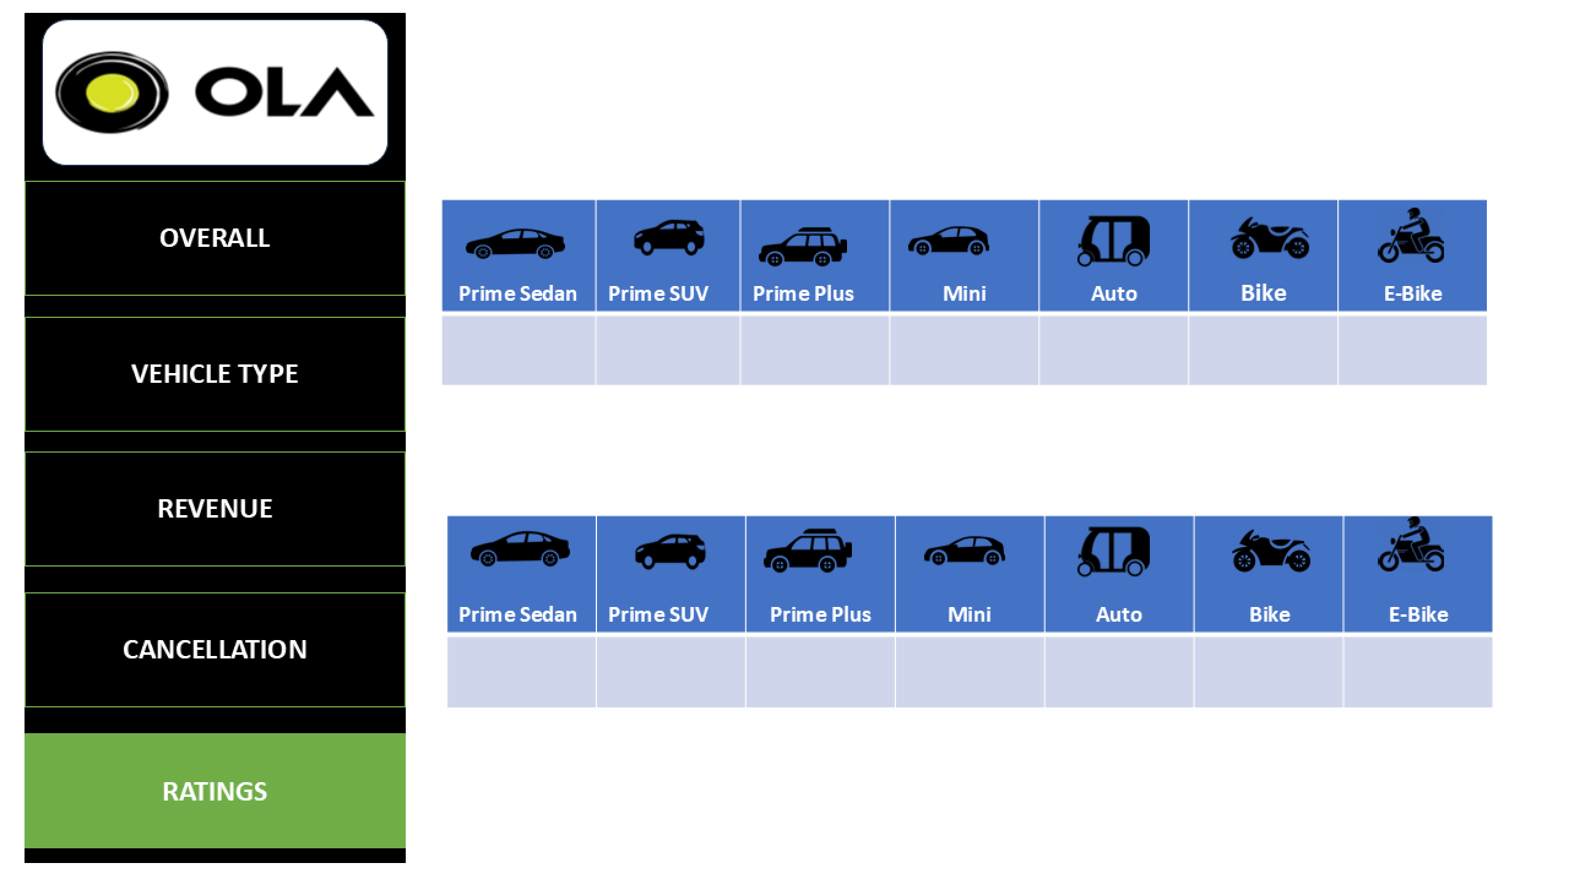


Power BI Desktop
Date 
01-07-2024 
30-07-2024 
Driver Rating
4.00 4.00 4.01
3.99
3.99
3.99
4.00
Customer Ratings
3.99
3.98
4.00
4.02
4.00
3.98
3.98

